Slide 1

March 2017
John Saunders, WO
My story

Slide 2

Agenda
About me
My background
The challenges
The days
The rewards
My digital work

Slide 3

About me
“To be honest I would never recommend the service to anyone.”
John Saunders
Wing Officer
Work in induction
16 years in the service
Emotionally connected
Instinctive improver
Unstoppable mender
But...
A frequently disappointed optimist
“There’s a lot of things I don’t tell my wife. She doesn’t need to know those kind of things.”

Slide 4

The challenges
Prison system = Frankenstein’s monster/no silver bullet
Poor and difficult communication
Fragmentation - loss of knowledge at every fracture
Time wasting administrative duplication
'Ideal world' horseshit thinking
Inflexibility - old policies + limited appetite for change
Armor (work and home)
The daily fear of assault
Seeing the same face again - disappointing
Loss of sleep worrying about prisoners
Getting dragged down by frustration/The sad eye mask
"Everywhere else people run away from fights and fires - it takes a funny kind of person to keep running towards them”

Slide 5

The days
The most challenging days and how they affect us

Slide 6

The days
The most rewarding days and their affect

Slide 7
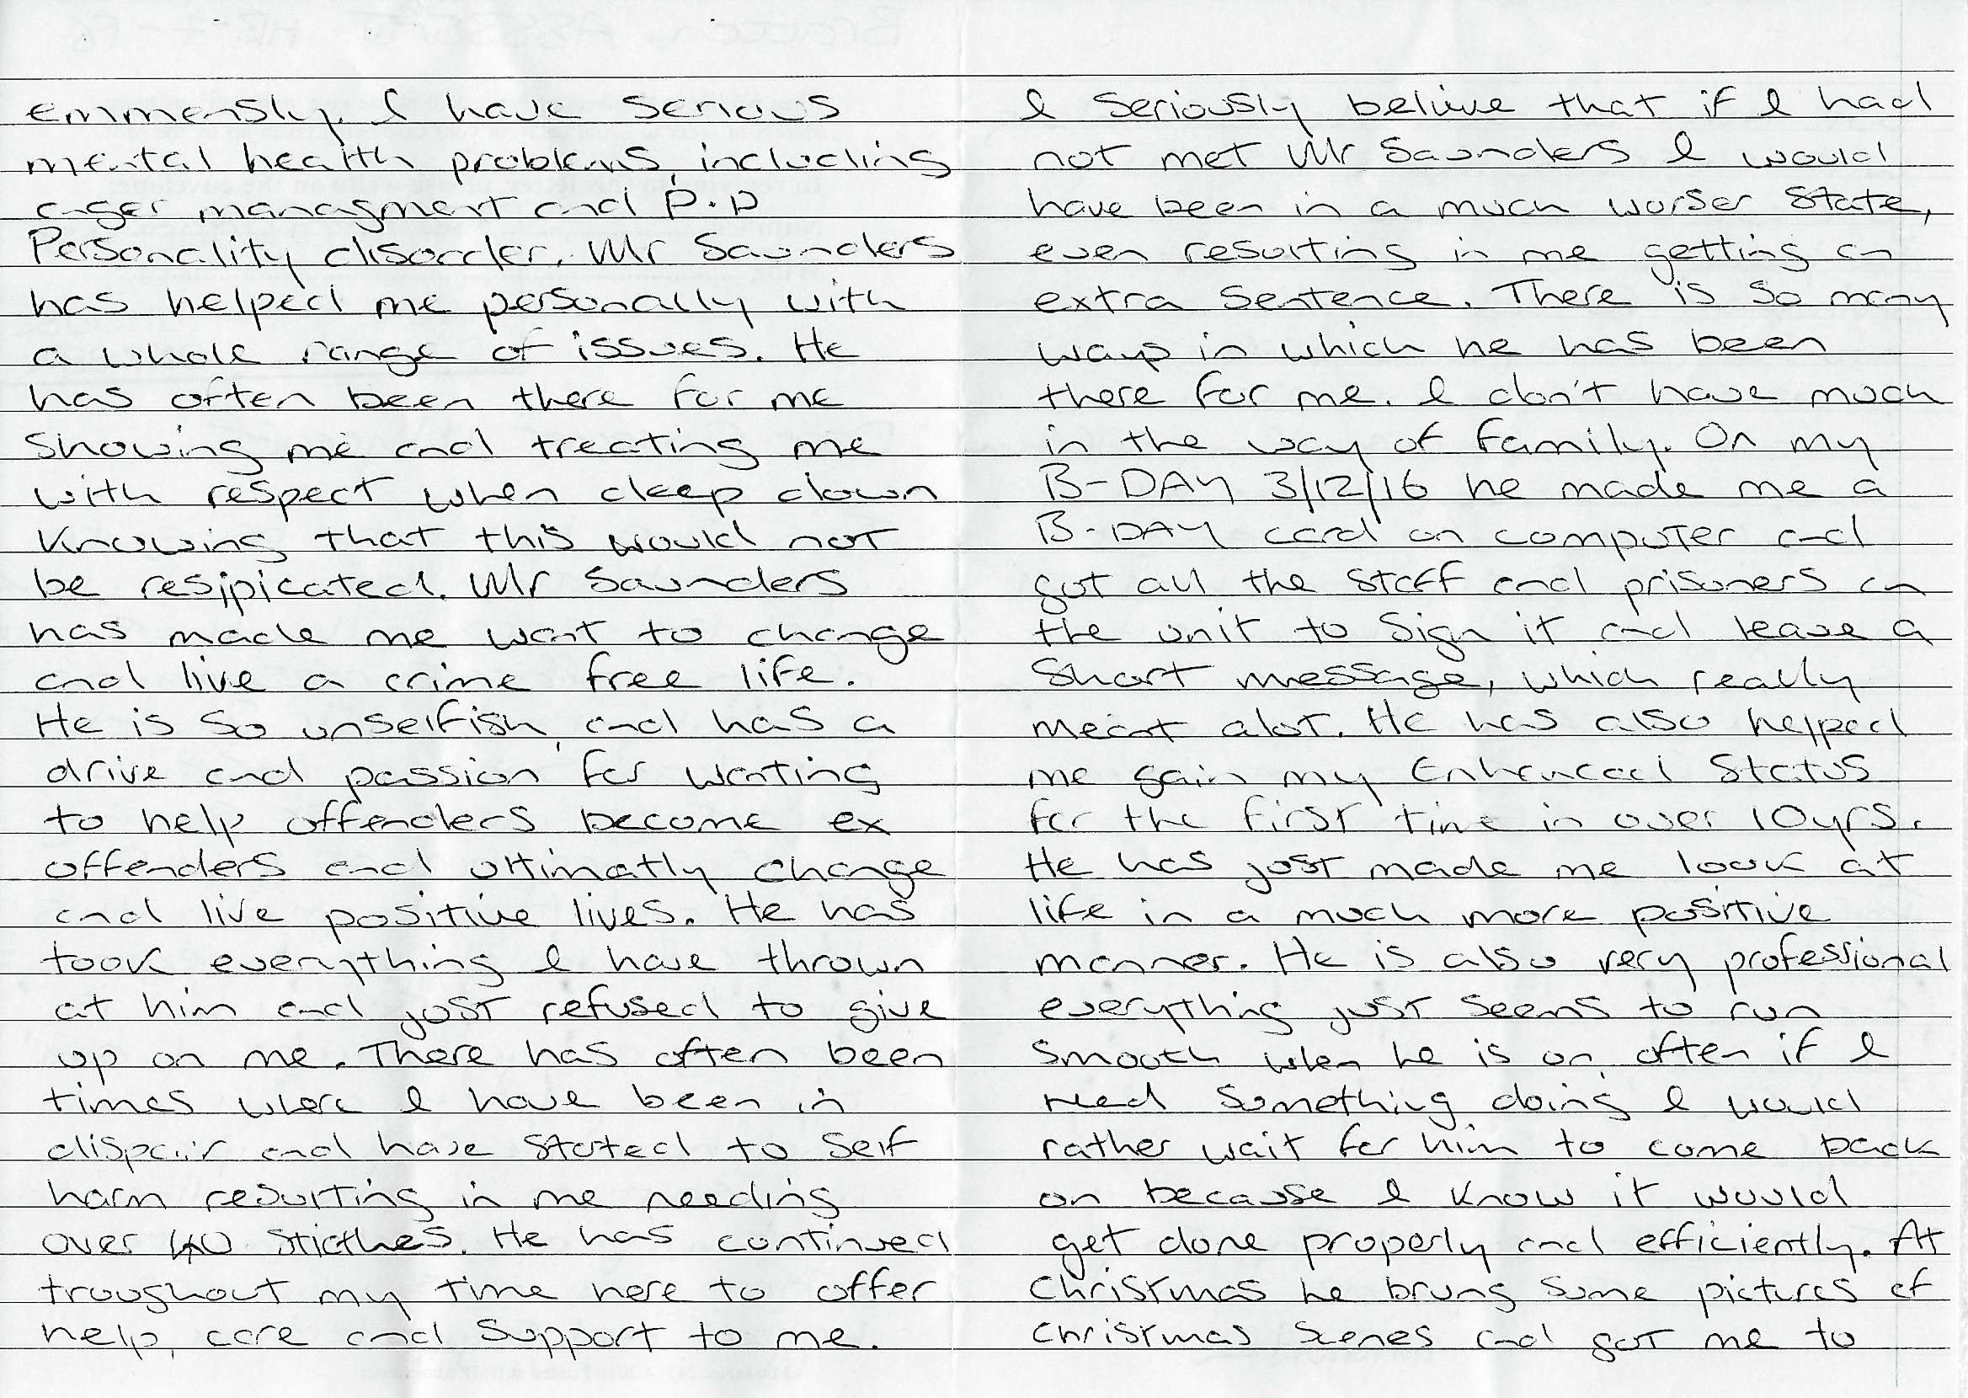
The days

Slide 8

The rewards
Getting my ‘hit' of difference making
Make things better
Helping by making real relationships and connections
Giving respect even when not earned (yet)
Spitting in the face and apology
Getting heard
Getting approval for out of the box thinking

Slide 9


Coping strategies
"Everybody is a Genius. But If You Judge a Fish by Its Ability to Climb a Tree, It Will Live Its Whole Life Believing that It is Stupid.”
Being creative as stress relief
Focus on the positive
Ignore the grey cloud brigade
Relentlessly hopeful and optimistic
No grudges "Every day is a new day”
Taking pride knowing I have done my best each and every day.
Albert Einstein

Slide 10
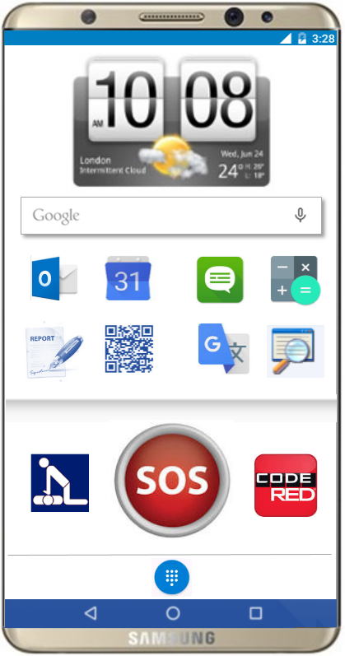
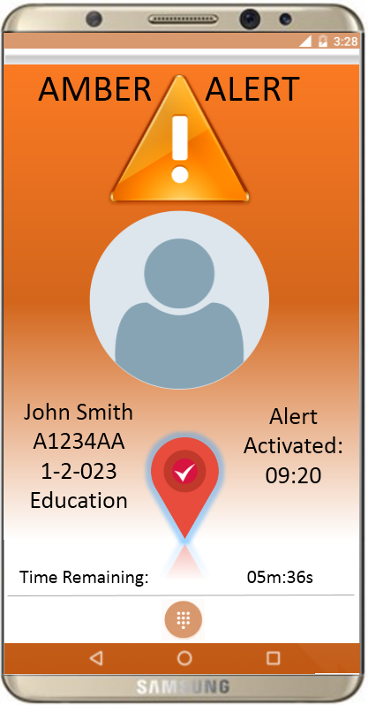
My mobile recommendations

Slide 11
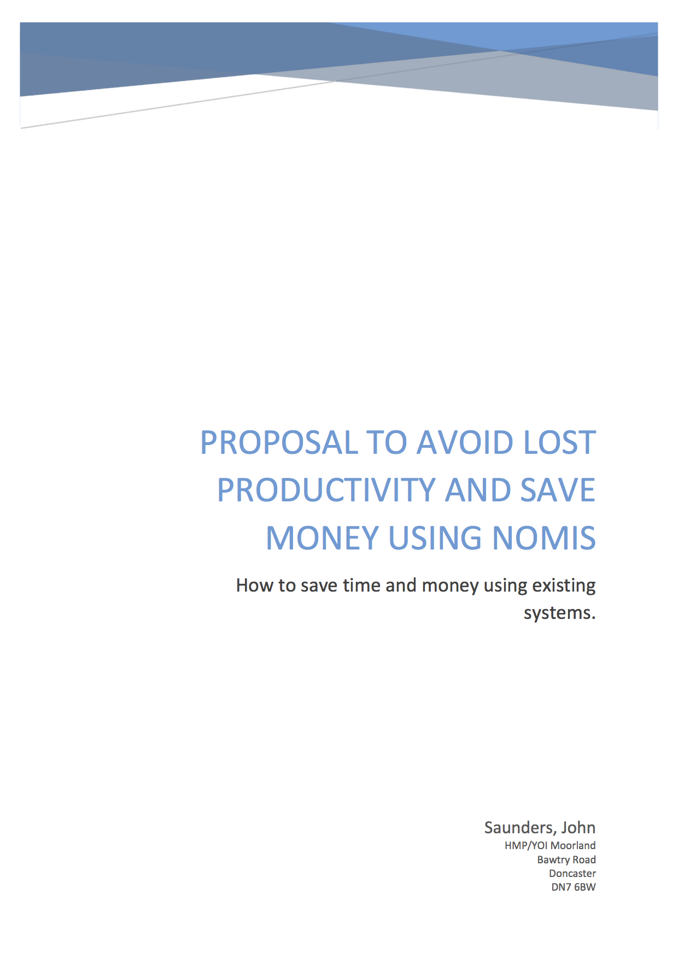
My recommendations for NOMIS

Slide 12
What next?
I would like the opportunity to use my experience and passions to get involved in the studio as much as possible and help not just modernize the prison service but to but to help it and the people working there to achieve their full potential as a business and as individuals.

